Slide 1

Book recommendation system project

Slide 2
PROJECT TEAM GROUP 6
Mentors
Madishetti Rajashekar
B Harish
Team members
Nikhita Khelgi
Boddu Venkata Malini
Pamula Veerababu
Neha Kamble
Shaikh Mabu Subani
Sharath Kumar K
Mihir Atul Humnabadkar

Slide 3
INDEX
Project objective and dataset
Data Pre-processing
Exploratory data analysis
Popularity Based Algorithm
Collaborative User Based Algorithm
Similarity Scores
Deployment
Challenges and Solutions

Slide 4
Project objective and dataset
The project is about building a recommendation system.
The primary goal is to give book suggestions based on user choice. Following algorithms have used:
Popularity Based algorithm
User based collaborative filtering
There are 3 datasets provided. Books, Ratings and User.

Slide 5
Data pre-processing
There are no duplicate records in any of the dataset.
Books and ratings dataset were merged on the ISBN column.
Wrong values in Year of Publication column have been fixed.
Null values in User dataset have been fixed using median function.
Outliers have been checked using Inter-quartile method.

Slide 6
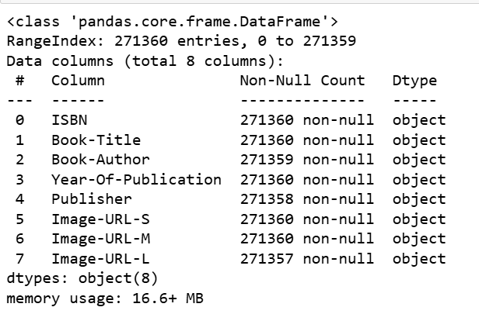
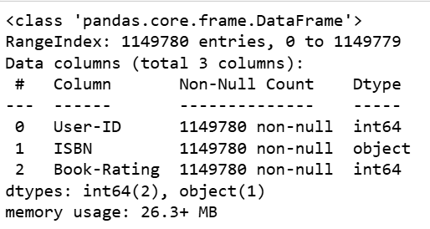
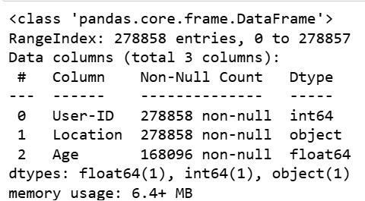
Exploratory data analysis
EDA has been done using pandas, numpy, seaborn and matplotlib.

Slide 7
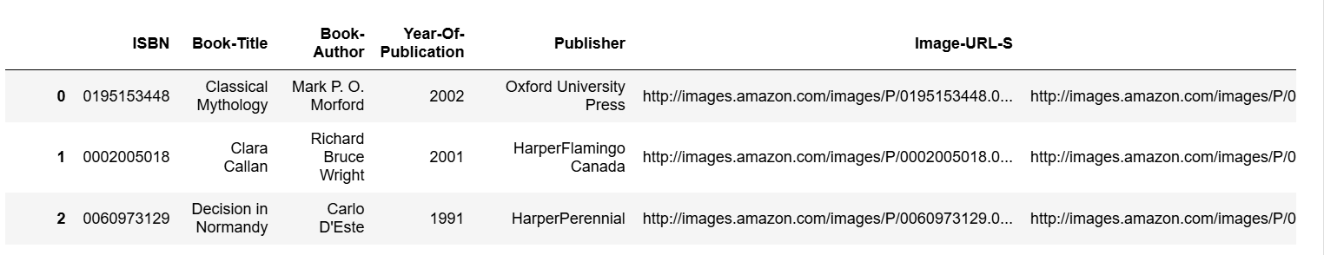
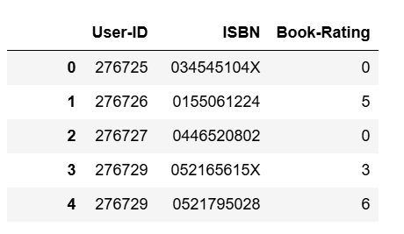
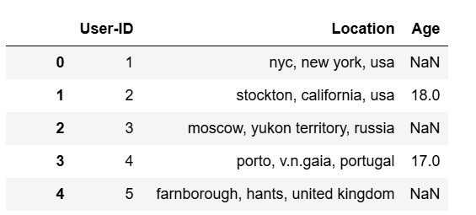
Exploratory data analysis

Slide 8
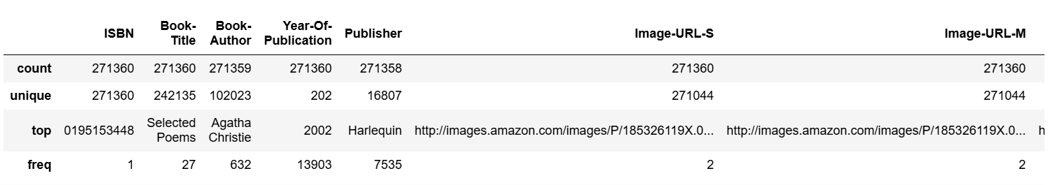
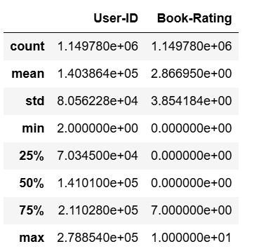
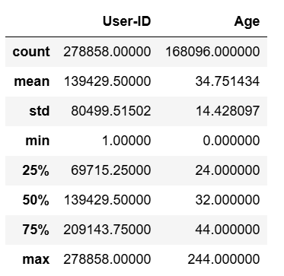
Exploratory data analysis

Slide 9
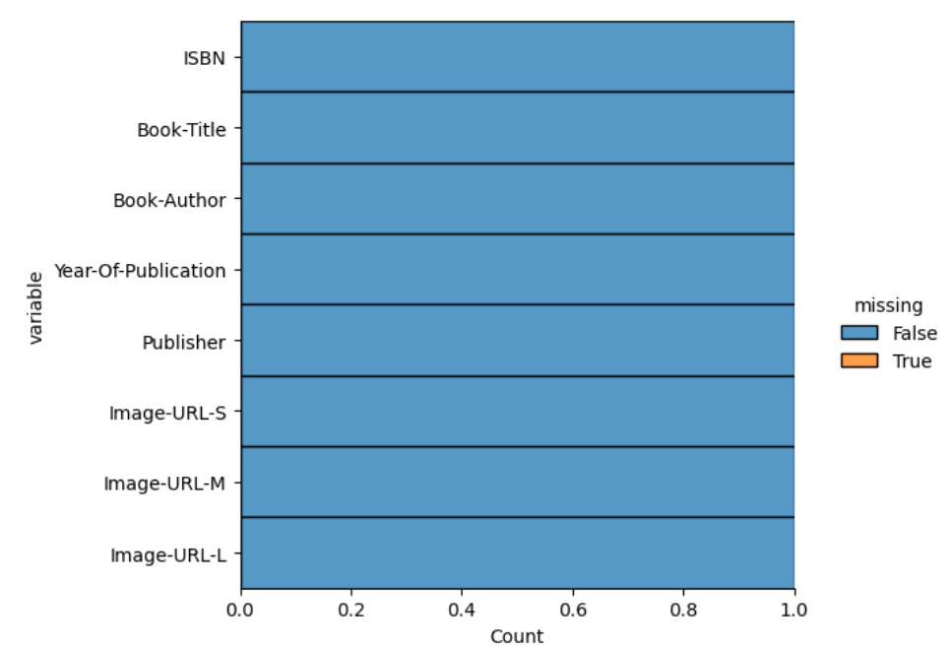
Exploratory data analysis

Slide 10
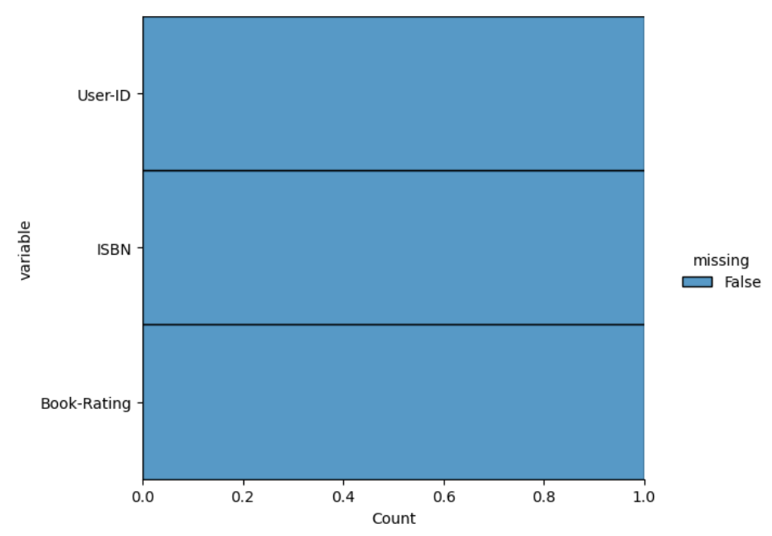
Exploratory data analysis

Slide 11
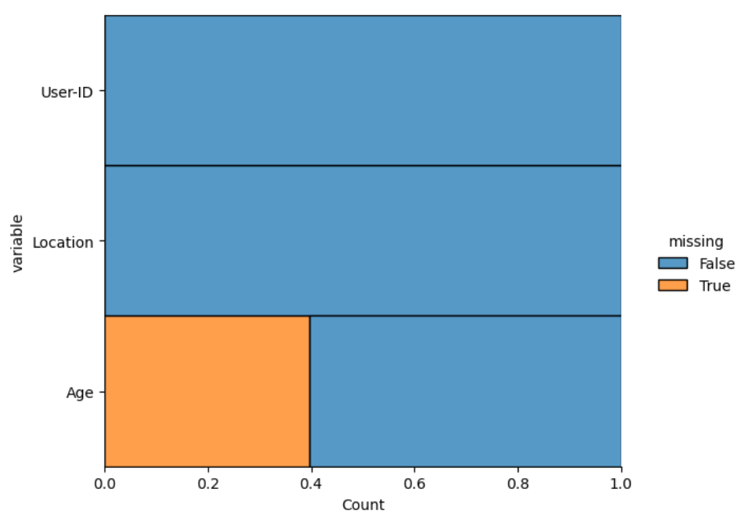
Exploratory data analysis

Slide 12
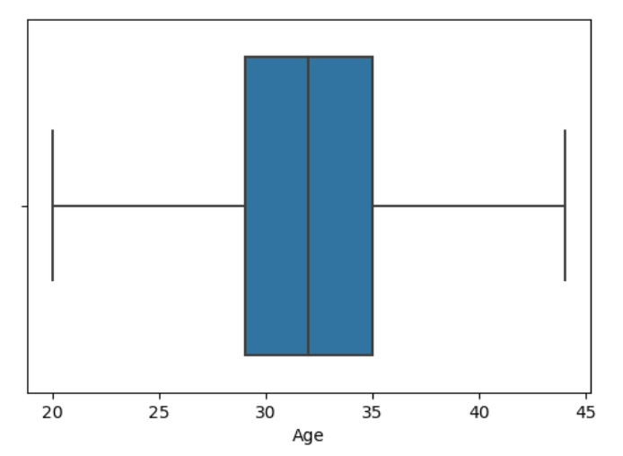
Exploratory data analysis

Slide 13
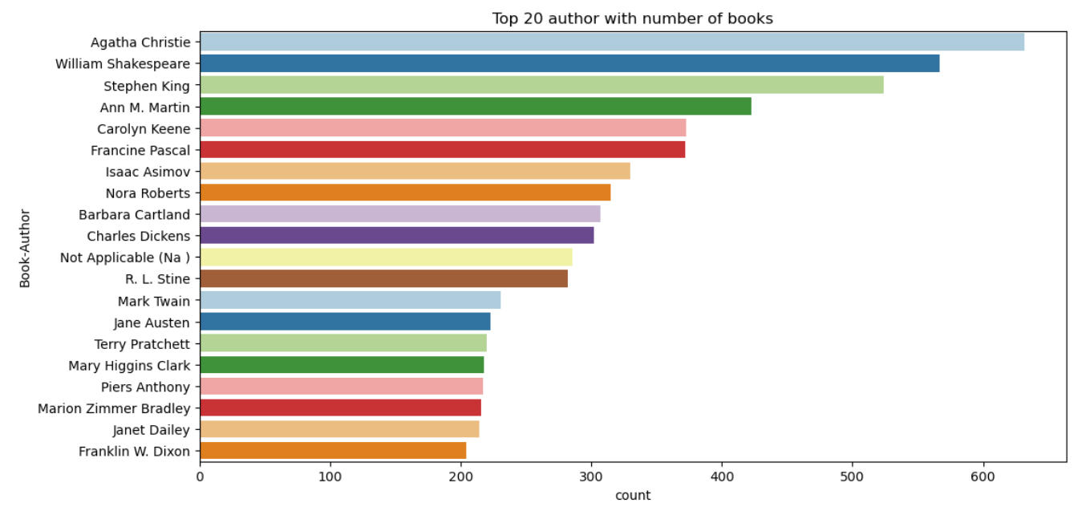
Exploratory data analysis

Slide 14
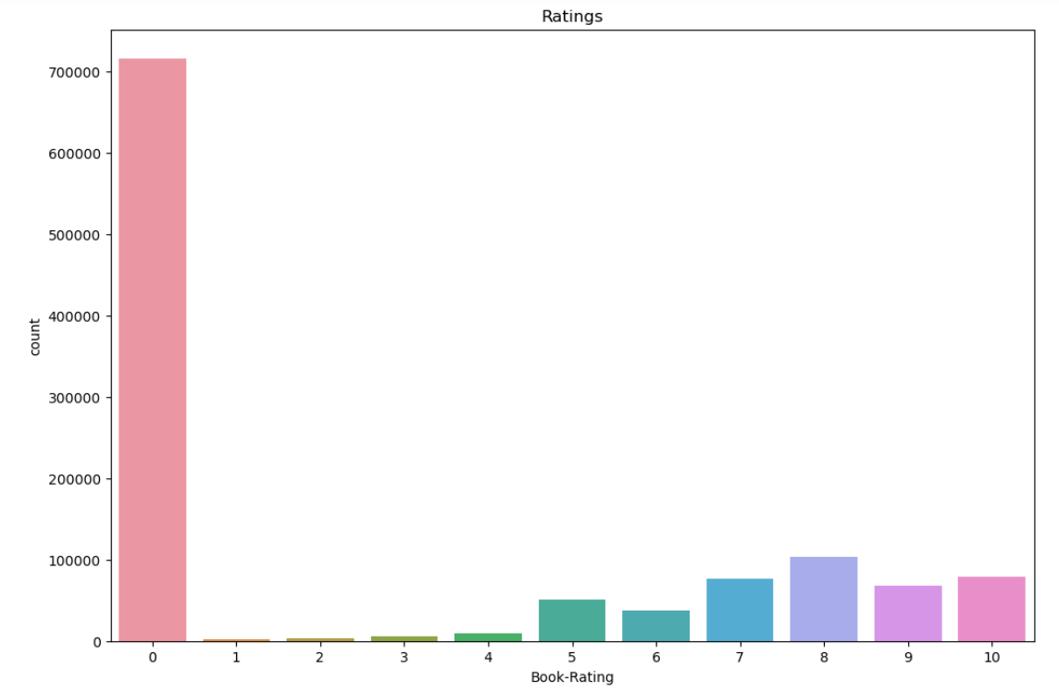
Exploratory data analysis

Slide 15
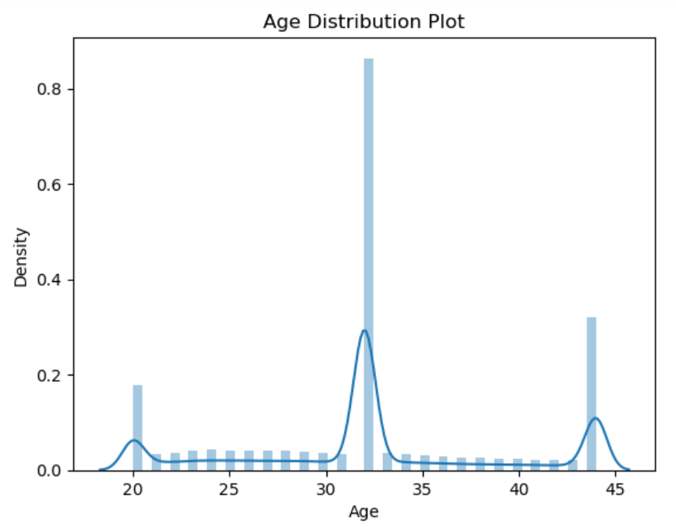
Exploratory data analysis

Slide 16
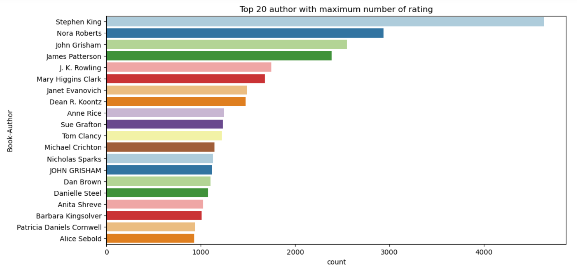
Exploratory data analysis

Slide 17
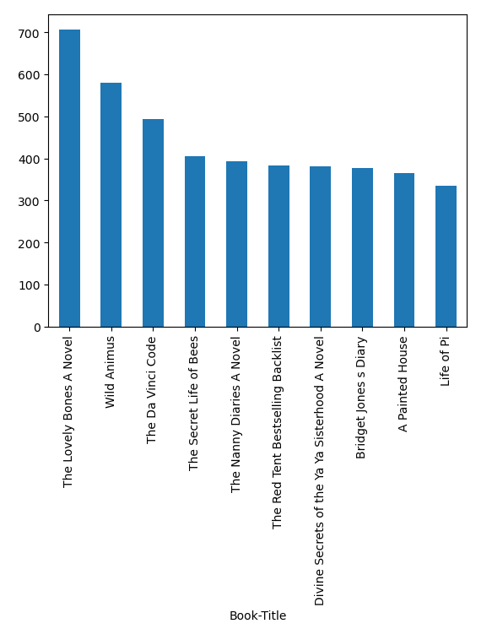
Exploratory data analysis

Slide 18
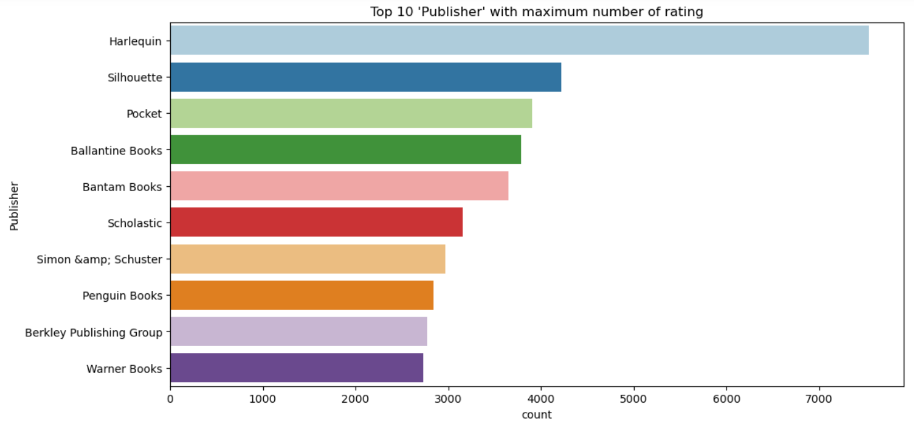
Exploratory data analysis

Slide 19
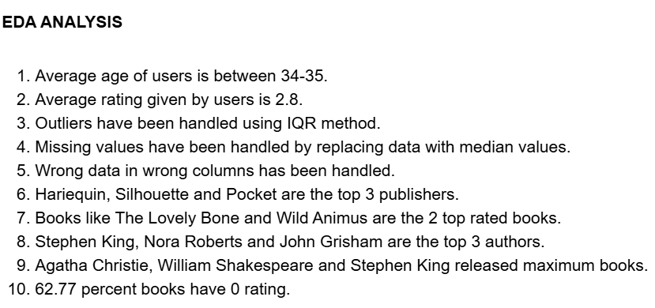
Exploratory data analysis

Slide 20
POPULARITY BASED ALGORITHM
Popularity based algorithm is based on recommending books which are popular
Popularity is calculated based on number of ratings.
The ratings and books dataset are merged based on ISBN.
2 sub datasets are created for getting number of ratings and average rating. Both these subsets are grouped on the Book Title.
Then these 2 subsets are merged based on Book Title.
Popular books dataset contains the books with number of ratings greater than or equal to 250 and are sorted in ascending order on average rating.
Finally the duplicates are dropped and popular dataset is created.

Slide 21
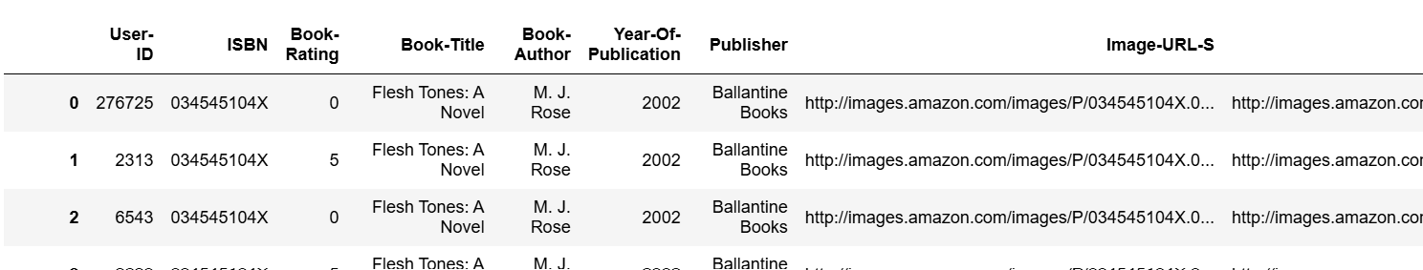
POPULARITY BASED ALGORITHM

Slide 22
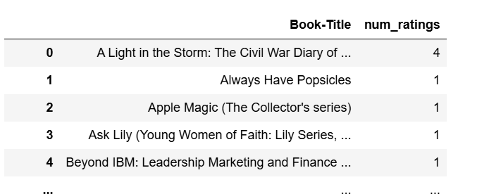
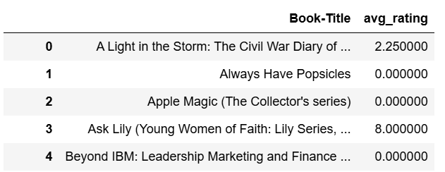
POPULARITY BASED ALGORITHM

Slide 23
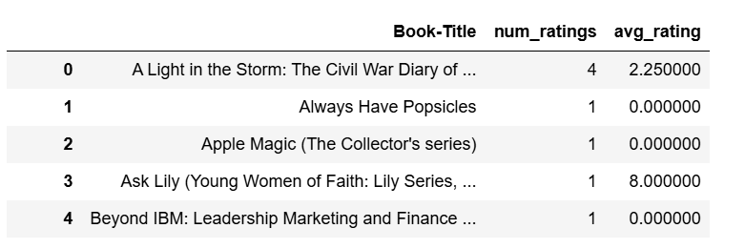
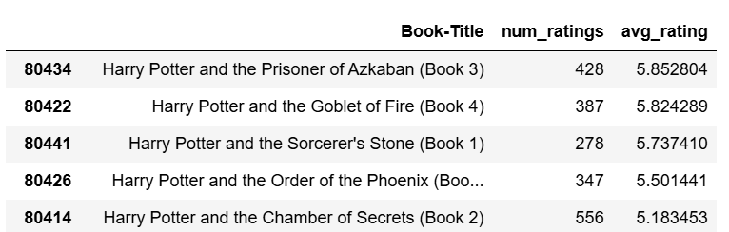
POPULARITY BASED ALGORITHM

Slide 24
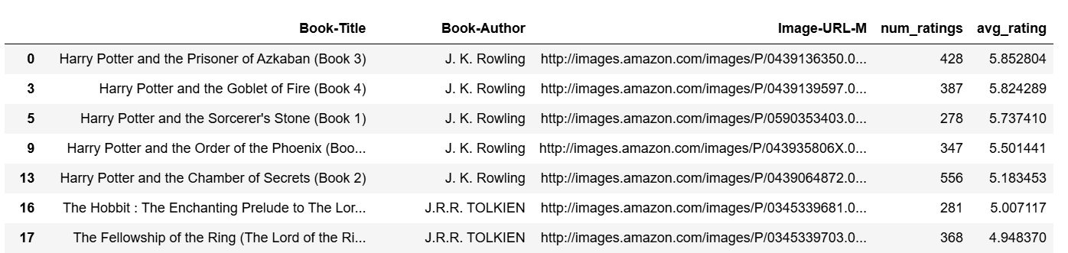
POPULARITY BASED ALGORITHM

Slide 25
Collaborative user BASED ALGORITHM
User based algorithm is based on users and ratings they give.
We first create a user base whose rating count is more than 200.
Then a set of books is generated which include users from the above data.
A new dataset called famous books is generated which include book ratings greater than equal to 50.
Final dataset is generated based on book title and then a pivot table has created of Book title and User ID with values as Book ratings.

Slide 26
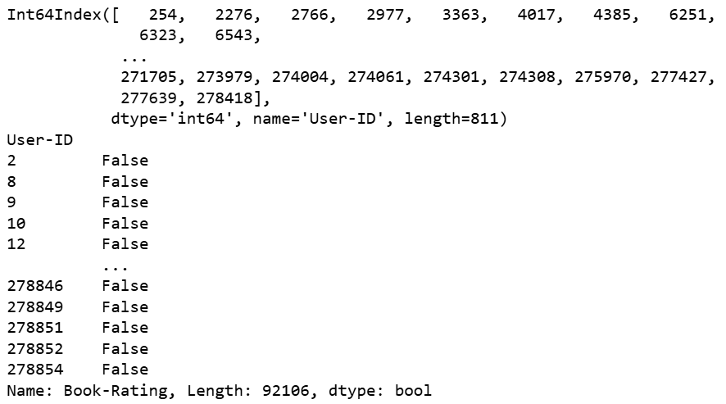
Collaborative user BASED ALGORITHM

Slide 27
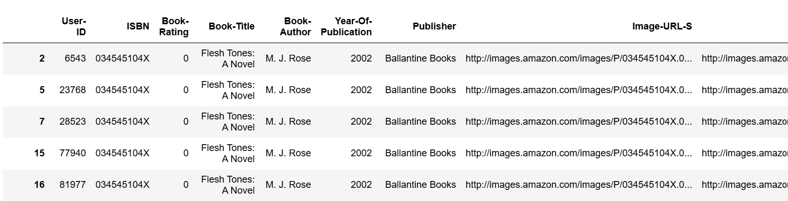
Collaborative user BASED ALGORITHM

Slide 28
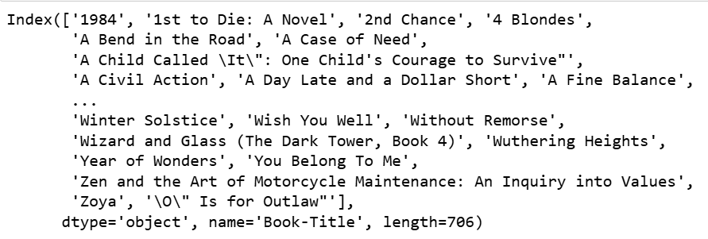
Collaborative user BASED ALGORITHM

Slide 29
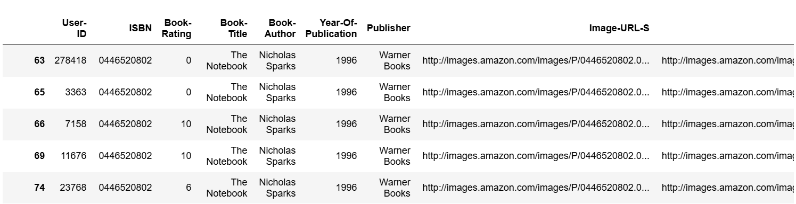
Collaborative user BASED ALGORITHM

Slide 30
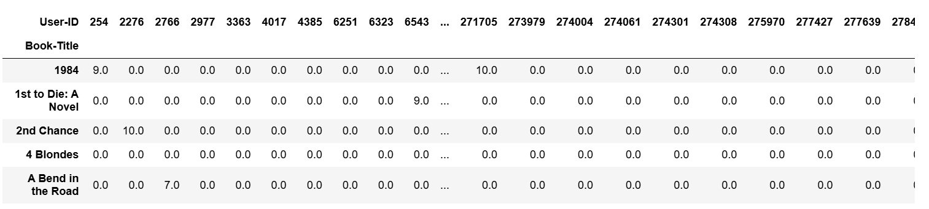
Collaborative user BASED ALGORITHM

Slide 31
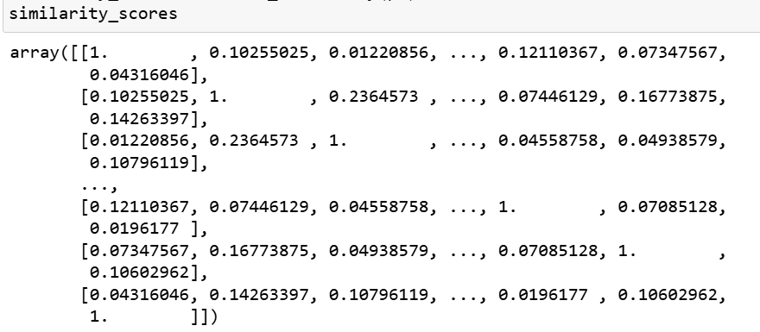
Similarity scores

Slide 32
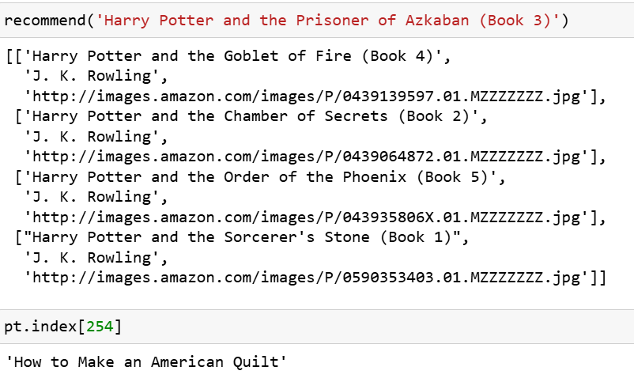
deployment

Slide 33
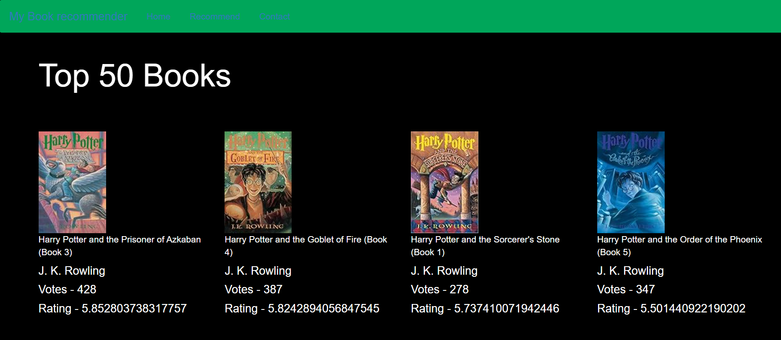
deployment

Slide 34
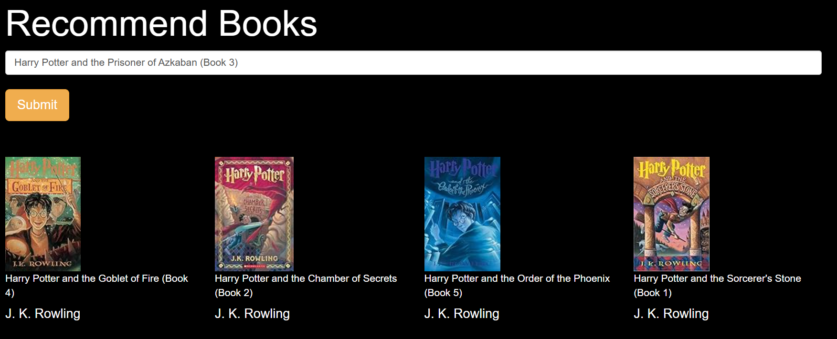
deployment

Slide 35
Challenges and solutions
Data had to be filtered and merged into a lot of subsets for effective output.
Wrong data in some columns had to be examined and corrected for data integrity.
Null values had to be handled.
For deployment the data had to be created in the form of a pivot table to fit the recommendation function.

Slide 36
Thank you!!!

